Slide 1
Woodland School District
2022-23 BUDGET Summary
Presented by:
Stacy Brown
Executive Director of Business Services
August 11, 2022

Slide 2
Enrollment History – Budget to Actual
Actual enrollment for 21-22 was 35.42 students less than budget. The estimated enrollment for 22-23 is 9 students less than the 21-22 budget and only 26 students more than the 21-22 actual average FTE.

Slide 3
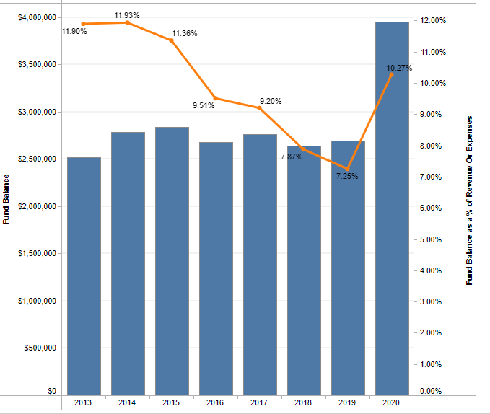
21-22 Budget
Historical Fund Balance/FB as a % of Expenditures Summary
This slide shows a history of actual ending fund balance and historical FB as percentage of expenditures. We often budget a decrease in FB, but if you look at the historical year-end FB, you see that we have increased FB in each of the past 2 of the past 3 years. Due to the pandemic, 20-21 is projected to have another increase in Fund Balance (between $500,000 and $600,000), with a % of 10.6% The projected increase in fund balance allows us to budget a much higher deficit than in past years ($494,000), while still maintaining a fund balance that is approximately 9.7% of expenditures.

Slide 4
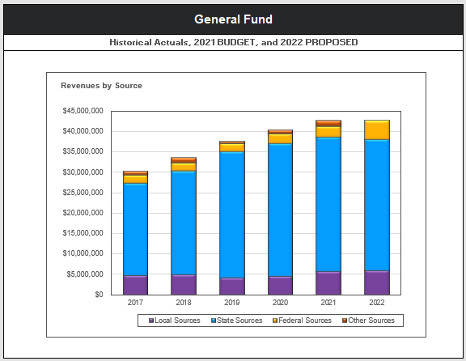
21-22 Budget
General Fund – Revenues By Source
For the 21-22 revenue sources, the “Other Sources” have decreased considerably (no Local Food Service Revenue).
Federal funds have increased considerably, due to the ESSER funds.

Slide 5
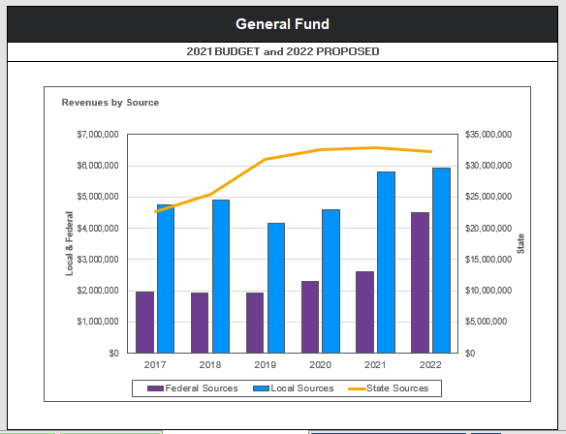
21-22 Budget
General Fund– History of Revenues By Source
This graph shows the changes we have seen in major revenues sources over the last several years. This shows the severe drop in local revenues from 2018 to 2020 and local taxes up in 2021, as a result of increased EP&O levy. It also shows the decrease in State funding due to decreased enrollment and Transportation funding. As in the previous slide, Federal Funds are much higher than in previous years.

Slide 6
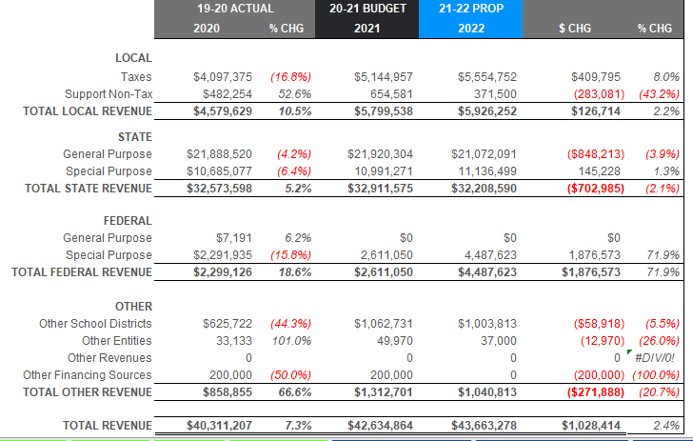
21-22 Budget
19-20 Actual, 20-21 Budget and 21-22 Budget Comparison – Revenues
Slide shows year to year budget comparison of revenues. Large increase in local taxes due to increase of 2021 levy. Local Non-Tax decrease of 43.2%, due to no collection of Local Food Service revenues and less projected WCC fees collected. State General Purpose decrease of almost $850,000 due to decreased enrollment. Federal Special Purpose increase due to Covid ESSER funds (not budgeted in previous years) and large carryover in Title One Funds not spent in the prior year. The large increase from other school districts is because of the expected increase in Transportation costs, but no expectation of large increases in funding to offset – being very conservative in this area. In the past I have budgeted to transfer State Forest funds from the Debt Service Fund to cover some technology costs, but this year I decided to transfer those funds to the Capital Projects fund to get a start on Scott’s 10-year maintenance plan.

Slide 7
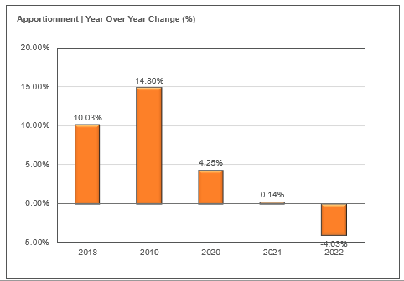
20-21 Budget
General Fund – Apportionment History
This graph shows the history of apportionment. There was just a slight increase between 19-20 and 20-21. We are budgeting for a very large percentage decrease in 21-22. This is primarily due to a budgeted enrollment decrease of 68 students.

Slide 8
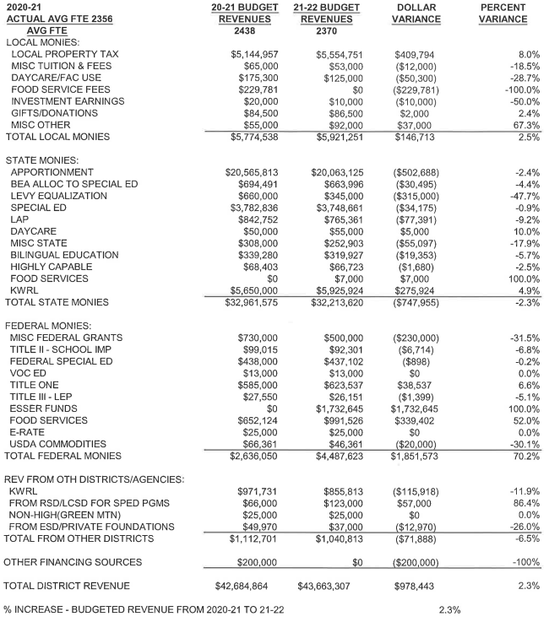
21-22 Budget – Detailed Revenue Comparison

Slide 9
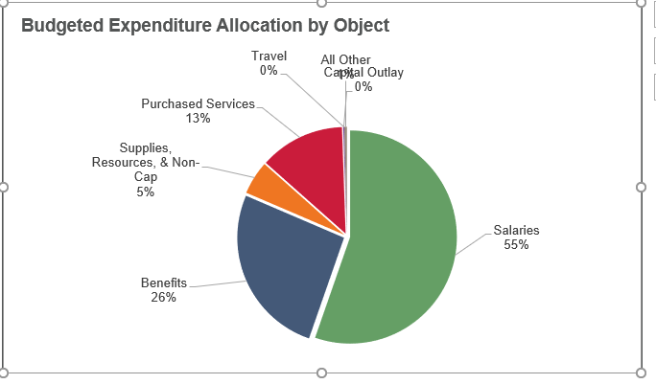
20-21 Budget
General Fund Expenditures
Salaries and benefits account for 81% of total expenditures. This is down slightly from last year, due to increases in budgeted curriculum and technology equipment (ESSER Funds).

Slide 10
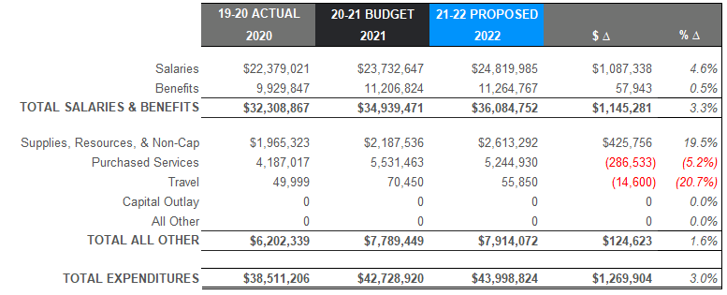
21-22 Budget
19-20 Actual, 20-21 Budget and 21-22 Budget Comparison – By Object
Slide shows increases from budget year to budget year. Increases in Salaries include negotiated increases, cost of living adjustments and small increase in staffing. The Benefit increase is smaller than normal, as the SEBB monthly fee decreased and retirement percentages decreased, These are the 2 most expensive benefits. We had increases to L&I and Unemployment insurance, but the percentages are very small. Large increase in supplies due mainly to budgeting for additional curriculum materials, technology equipment and COVID supplies with the ESSER funds, as well as $100,000 increase for fuel for the buses. Purchased Services decreased due to no longer being responsible for paying the contract for special ed students aged 0-2 ($125,000), mental health services previously contracted now budgeted in salaries/benefits ($45,000) and decrease in budgeting for capacity from $700,000 to $500,000.

Slide 11
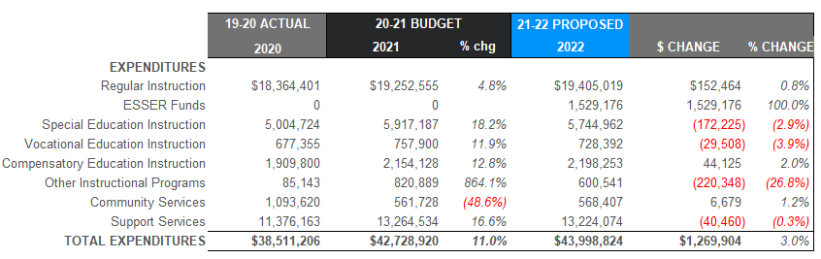
21-22 Budget
19-20 Actual, 20-21 Budget and 21-22 Budget Comparison – By Program
This slide gives a bit more detail (by program) and compares the 19-20 actual expenditures with the 20-21 budget and the 21-22 budget. All programs are increased due to increased salaries and benefits districtwide. Overall expenditures increased by 3.0%. The addition of the ESSER funds impacted some of the other programs, and that is why there are decreases as ESSER funds were used to cover salaries and benefits for COVID testing and tracking, technology staff to maintain the increased number of devices, additional mental health services and increased Special Education staff. These funds will also be used for curriculum supplies and additional technology supplies. Academic supports including summer school, before and after school activities and a position to work specifically with our Unaccompanied Youth (Homeless) students. Special Education increases due to increased enrollments and increases to outside placements. Other Instructional Programs include a line item of expenditures (with off-setting revenues) to increase budget capacity should we receive grants or increased revenues and expenditures after the budget has been completed. This was decreased from $700,000 to $500,000 in 21-22. This accounts for the large difference between the actual expenditures in 19-20 vs. the budgeted amounts.

Slide 12
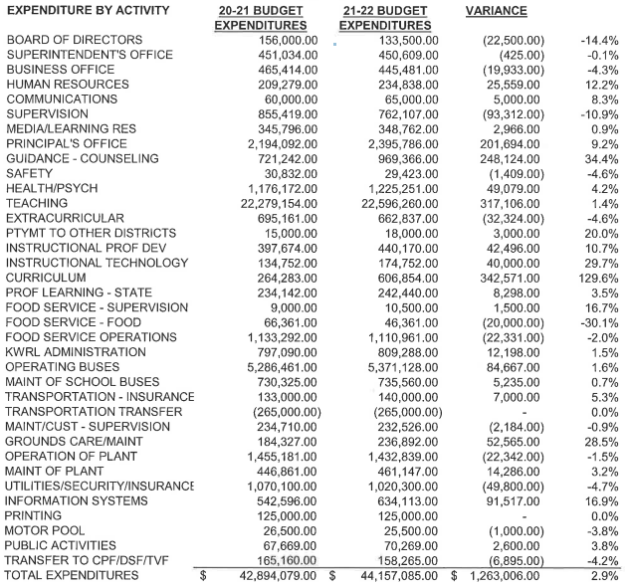
21-22 Budget – Expenditures by Activity

Slide 13
Uses of Levy/Enrichment Funds
Expenditure Type | Enrichment Funds 2021-2022
Certificated Salaries | $ 890,000
Classified Salaries | $1,732,000
Administrator Salaries | $ 567,000
Benefits | $1,050,000
MSOCS (Maerials/Supplies/Operating Costs) | $ 150,000
Extracurricular | $ 660,000
Special Education | $ 630,000
Food Service Program | $ 105,000
Family Resource Coordinator | $ 10,000
To/From Transportation | $ 361,000
KWRL Bus Purchase/Capital Allocation | $ 118,000

Slide 14
21-22 Budget
Transportation & Food Service
Transportation Revenues/Expend
Food Service Revenues/Expend
Revenues only include the state-funded revenues. We also receive payments from the other districts. Woodland’s portion of KWRL for 21-22 is $361,024 plus $118,265 for bus purchases
21-22 Food Service cost is approximately $129,000 in comparison with the previous year budgeted cost of $250,000. We made some staff changes and expect increased participation and revenues with student meals being free again this year.

Slide 15
21-22 Budget
Before and After School Care
For many years, the WCC and YCC programs have provided opportunities for parents and students in a small community without many daycare options for families.
The YCC program has not been utilized by the families at Yale the last couple of years and the program was reopened in the Spring, but there is not enough need to continue and finding staff has been difficult. It may be open for 21-22, but only for Monday mornings.
The programs served about 120 families throughout the year at Columbia and North Fork. They also provide summer care at Columbia.
The WCC program is licensed by the state and able to provide options for low-income families.
Daycare programs are budgeted to run at a loss of $104,000 for 21-22 (in comparison with $62,000 in 20-21). Opening NFES added one additional staff and the full benefits for that staff member. With the pandemic, WCC has had to staff at a lower ratio of staff per students to ensure they can meet the social distancing requirements. For 20-21 they were open full days for most of the year until WMS went back to school full time in April. Depending on what the revenues look like for 21-22, there may be an option to use ESSER funds to offset some of the increased expenditures.

Slide 16
21-22 Budget
Staff Changes
Certificated Staffing changes include decreases in WHS Science and CTE (1.4), increases in Counseling/Social Work (2.0), Media (.35) and Yale School. Other changes that did not result in increases or decreases include moving 2 staff back to their buildings from LRA and returning the K-4 specialists from classrooms teaching to their specialist positions. We also had two unfilled K-4 teachers and 1 SLP that were budgeted, but unfilled in 20-21. These are all budgeted for 21-22.
Classified changes include increases in classroom and health room Para staff in Basic Ed, Special Ed and TEAM High. The budget also includes increase in LPN’s and Technology Staff. Decreases include the Behavior Specialist position (attrition).

Slide 17
Other Funds
Capital Projects
Debt Service
ASB
Transportation vehicle

Slide 18
CAPITAL PROJECTS FUND
Beginning Fund Balance $ 690,000
Revenues/Other Financing Source $ 342,000
Expenditures/Financial Uses $ 700,000
Ending Fund Balance $ 332,500

Slide 19
DEBT SERVICE FUND
Beginning Fund Balance $ 1,683,000
Revenues/Other Financial Source $ 3,537,450
Expenditures/Other Financial Uses $ 3,940,000
Ending Fund Balance $ 1,280,450
Debt Outstanding 9/1/21 = $47,670,000

Slide 20
ASB FUND
ASB funds are for the extracurricular benefit of the students. Their involvement in the decision-making process is an integral part of associated student body government.
Beginning Fund Balance $ 250,000
Revenues $ 357,250
Expenditures $ 375,500
Ending Fund Balance $ 231,750

Slide 21
TRANSPORTATION VEHICLE FUND
This fund is used to replace buses for the KWRL Cooperative districts. Revenue comes from the State (in the form of depreciation payments), interest earned on the investments and the annual payments made by the four member districts (Kalama, Woodland, Ridgefield and La Center) to cover options and buses necessary for growth. This fund is fully self-supporting with state depreciation funds.
Beginning Fund Balance $ 2,474,000
Revenues $ 1,070,000
Expenditures $ 2,000,000
Ending Fund Balance $ 1,544,000

